Slide 1
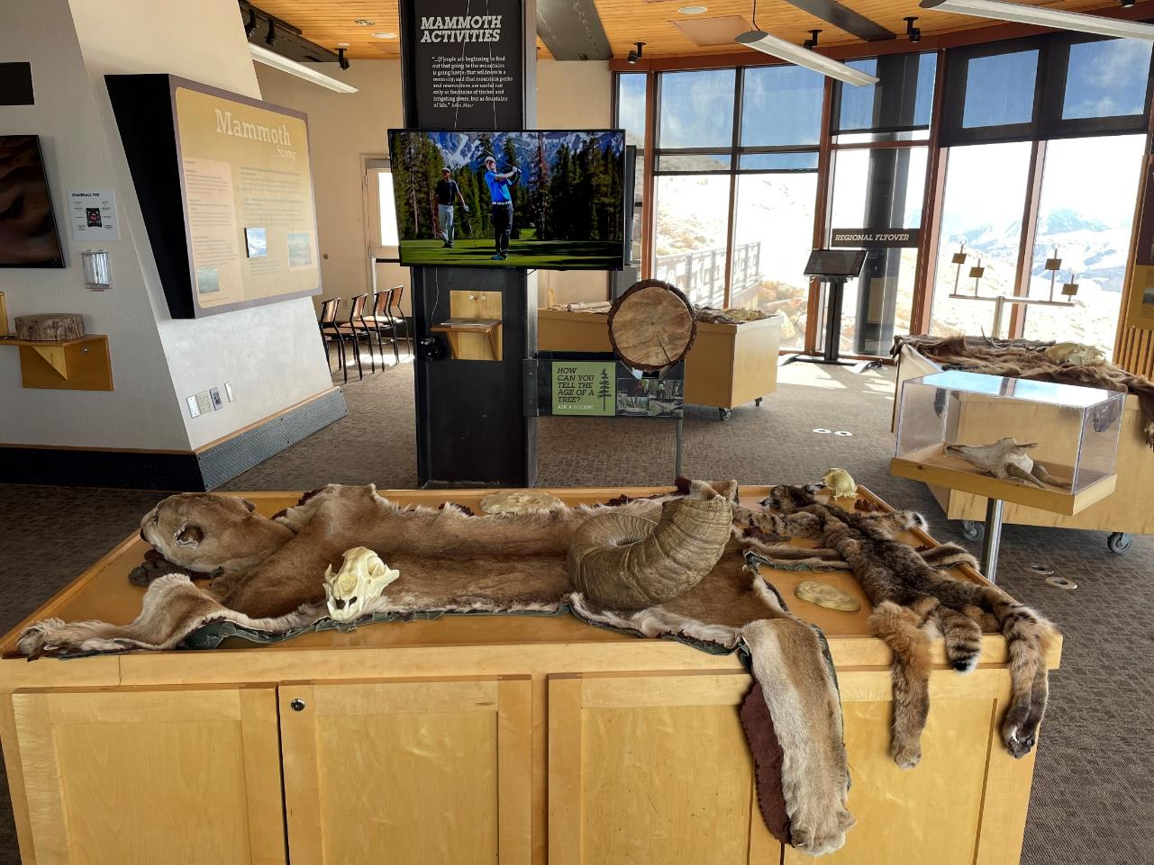
1153 Reference Information

Slide 2
The Interpretive Center – General Info
There are 7 TVs, 4 large tables with cabinets underneath, bighorn sheep skulls, a tree log for boring, viewing tubes, a rock table, a sandbox, and more
We store most things in the cabinets under the tables. That is where you can find storage bins for the animal skins and all other table top objects, as well as the electronics cabinet. Each cabinet locks
The electronics cabinet is on the left hand side underneath the table with the 3D topo map of the area on it, in front of the Docent Station
In the electronics cabinet, you will find all of the keyboards, trackballs, remotes, extra batteries, log boring tools, and more
Make sure to keep all of the cabinets locked at all times when not using them

Slide 3
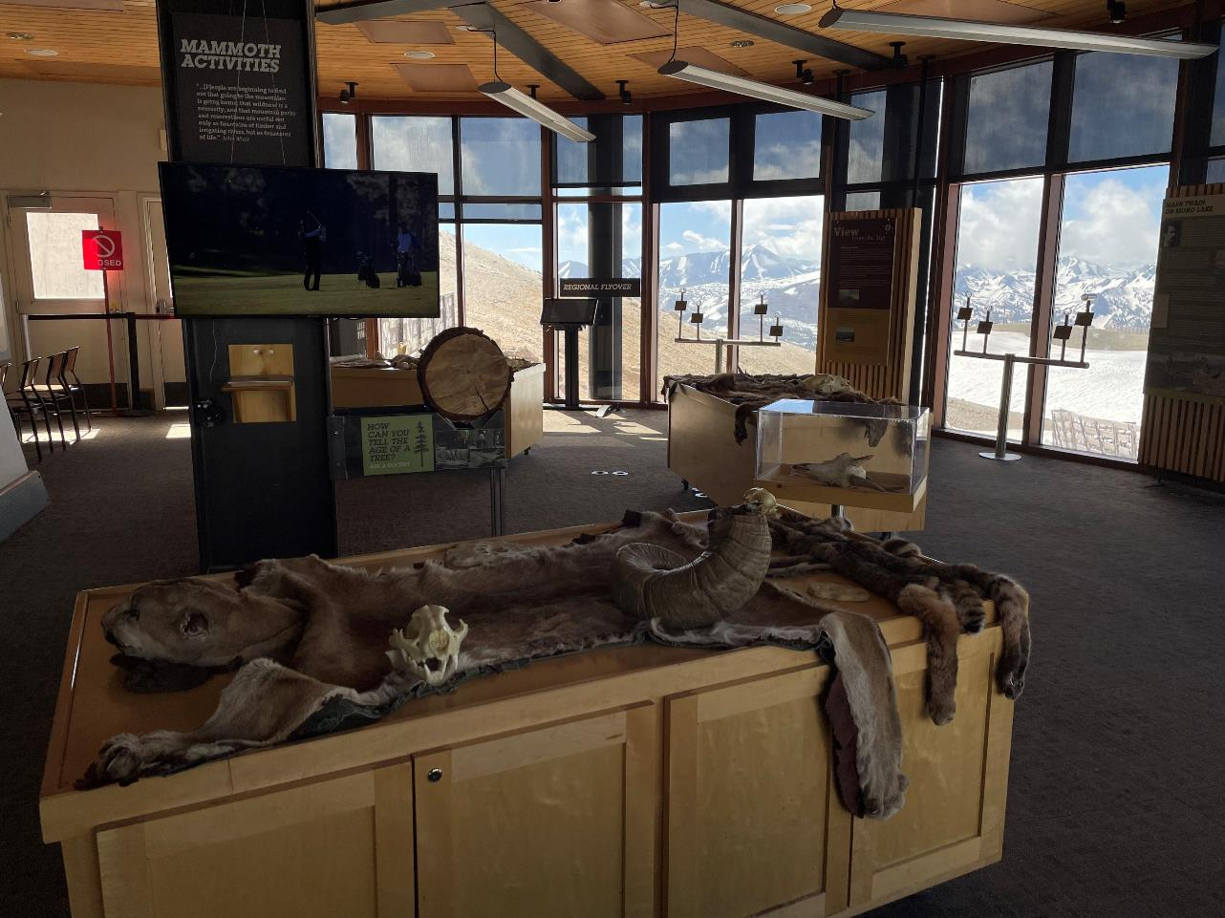
Regular Opening Procedures
Opening:
When you arrive at the summit, head downstairs and identify the lock box to the left of the front doors, at about eye level
The code to the lockbox is 153. Enter the code and push the tab down to open the box
Unlock the doors and immediately put the keys back in the lock box to avoid them getting locked inside the center. The code will need to be put in again in order to lock the box
Turn on the lights and the 1153 radio so we can contact you up there
You can place your bag or items in the small closet to the right of the front doors. The keys to the cabinets, kitchen door, and front doors will be hanging inside the door to that closet
Turn on all of the trackballs, then exit the slideshows so all of the TVs are back on their front page menus
Grab the keys from the closet, open the cabinet under the rock table, and remove the bucket. Go around to the kitchen door by the bathrooms and unlock it. Use the sink to fill the bucket, and you can re-enter the center through the other kitchen door that leads directly into it
Ensure everything looks clean and ready and have fun!

Slide 4
Normal Closing Procedures
Begin by locking the front doors once the guests have exited to avoid anyone else coming in
Turn all of the TVs into slideshow mode – whichever scenic slideshow you’d like
Turn off all of the trackballs, but leave them where they are
Open the drain for the water at the rock station so it drains into the bucket. Then dump the water from the bucket into the kitchen sink
Use the sponge to clean up any water on the table top
Make sure everything is clean and organized for opening in the morning

Slide 5
Quiz!
The code to the lockbox is ____
Where can you find the trackballs when they’re put away?
Where are the keys for the cabinets kept?
_____________ the trackballs when you’re closing
How do you get into the kitchen for access to the sink?
We store most things in the_________________

Slide 6
How to Use the TVs and Their Computers

Slide 7
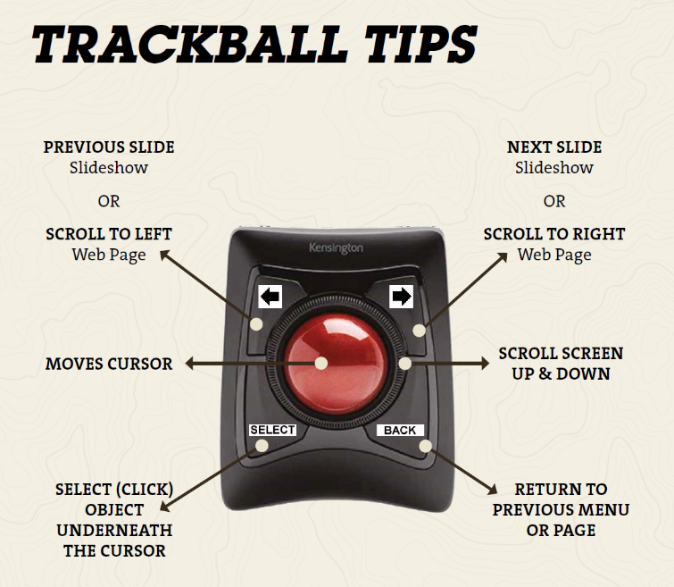
Trackballs works like a computer mouse. Move the trackball around to move the mouse on the screen
Use the SELECT button as your left mouse click to select or click anything
Use the BACK button to return to the previous page
Slideshow and further trackball instructions in 2 slides
The ON/OFF switch is located on the back side of the trackball where you can also see which monitor the trackball goes with. See next slide
THE RED BALL IS CALLED THE TRACKBALL
THE BLACK OBJECT IS CALLED A TRACKPAD
THE RING AROUND THE TRACKBALL IS CALLED THE SCROLL RING
PRESS BOTH AT THE SAME TIME TO TOGGLE SLIDESHOW ON/OFF

Slide 8
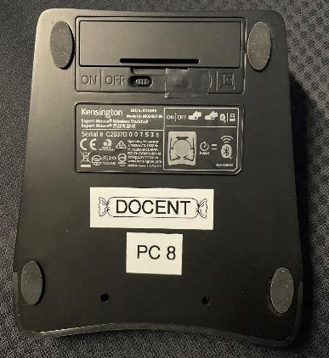
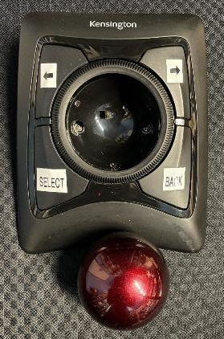
The trackpads have an on/off switch on the bottom. This is also where you can see which computer the trackpad is paired to go with
The trackballs are loose in their position. When the trackpad is turned upside down, the ball will fall out. Hold onto it when turning the device upside down
Each remote is a little different. All of them have a brand name on the bottom and a power button at the top

Slide 9
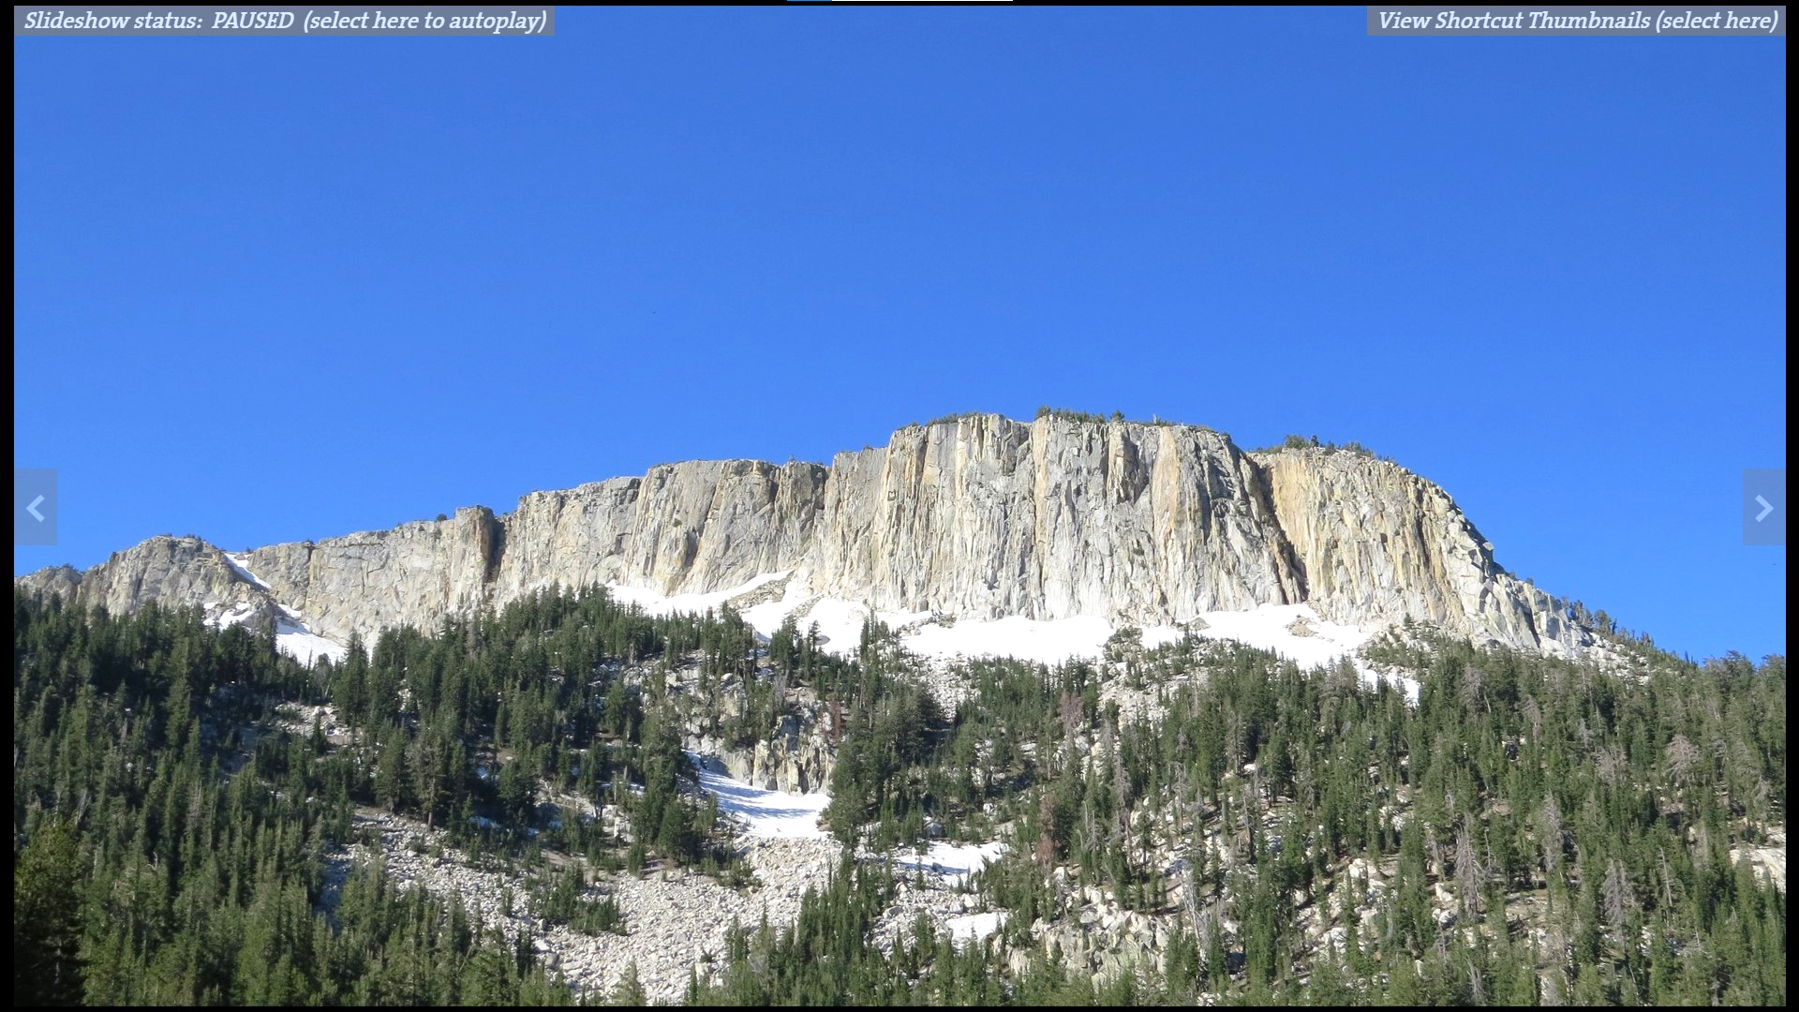
After pressing SELECT and BACK at the same time, these 2 gray bars appear on the screen
Use the SELECT button to click anywhere on this gray bar to begin and to pause the slideshow
Click here using SELECT to open thumbnail images to skip to a specific image

Slide 10
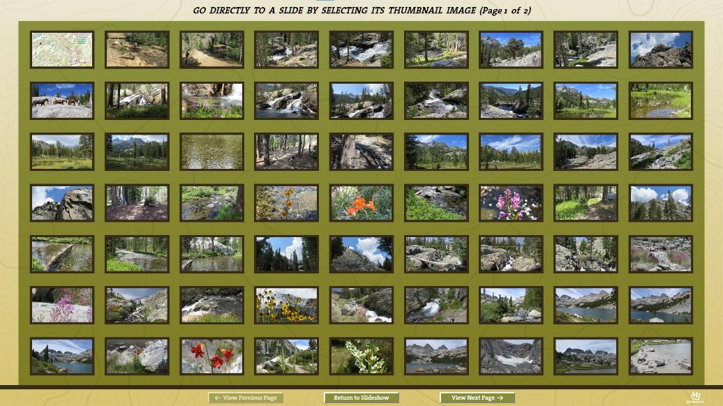
This is what is displayed after clicking the right hand grey bar from the previous slide. Click any image to view it in full screen. Press the BACK button to come back to this screen. Press “Return to Slideshow” or BACK to exit the thumbnail screen.

Slide 11
Quiz!
The ______ button on the trackpad acts as your left mouse click
The red ball is called the __________
Use the ______ button to return to the previous page
Press _______ and _______ at the same time to expose the menu option to begin a slideshow
How do you turn on and off the trackballs?

Slide 12
When there is a white dot, click title or image to open sub menus
No white dot means no sub menu

Slide 13
Use this button or BACK button on trackpad to go back

Slide 14
Mute/unmute sound
Enter/exit full screen
Play/pause video
Use the mouse & SELECT button to click anywhere on this bar to skip to that part
Adjust playing speed

Slide 15
Blue dot means it leads to a website if you click on it. Websites are interactive
No blue dot just leads to another page. Non interactive
Next slide is about this

Slide 16
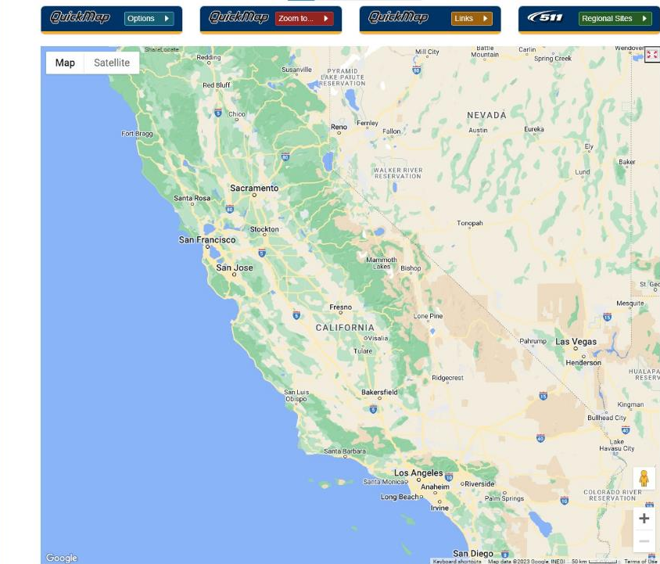
CalTrans Interactive Highway Map
When opening the program, it will start on a map of the US. In a few seconds, it will zoom into Mammoth
With your mouse in the map area, use the scroll ring to zoom in and out
Hold the SELECT button down and use the trackball to move around the page. Or use the arrows on trackpad
Click BACK to exit out of the program

Slide 17
Quiz!
What signifies that there is a sub menu that will open when you click on a topic?
What signifies that there is a website that will open when you click on a topic?
When watching a video, press ________ and ________ at the same time to open the table of contents
With your mouse in the area you want to scroll in, use the ________ ________ to zoom in and out
How do you move around and explore the map on the webpage?

Slide 18
Some web pages are static like this Mammoth Patrol Weather site. You can scroll up and down using the scroll ring, or use the arrow to go right and left. Put the mouse in the area you want to scroll in. No zooming capability

Slide 19
Wildflowers organized by color are all still photos that can be magnified
Flowers with multiple phases have a manual slideshow attached. Flowers that have 1 phase only have 1 photo
Wildflowers organized by color have no automatic slideshow capability. Use trackpad arrows to go back and forth between photos
The Wildflowers Overview and Desert Flower Bloom can be turned into automatic slideshows (notice they have no sub menu because there’s no white dot)

Slide 20
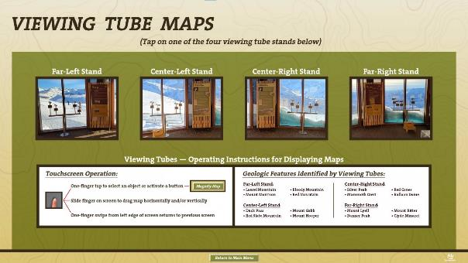
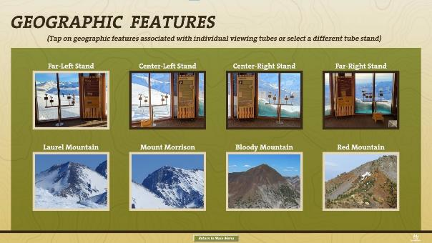
An awesome new feature on the weather station is the viewing tube maps. Click on each viewing tube set to see an image of the mountain or feature each tube is identifying

Slide 21
2. Then this pops up
3. Press both arrows at the same time on the trackpad to pull up the number pad to type in 1153 in the prompt at the top of the screen as shown
1. Click this first

Slide 22
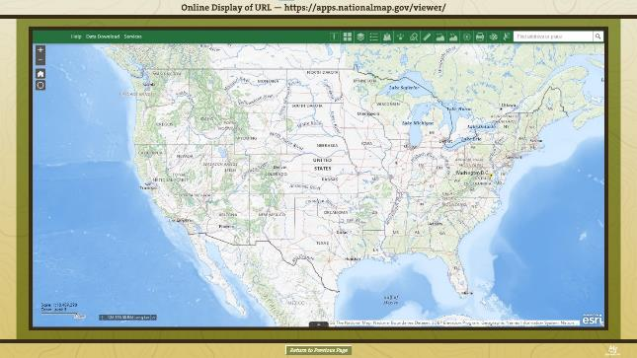
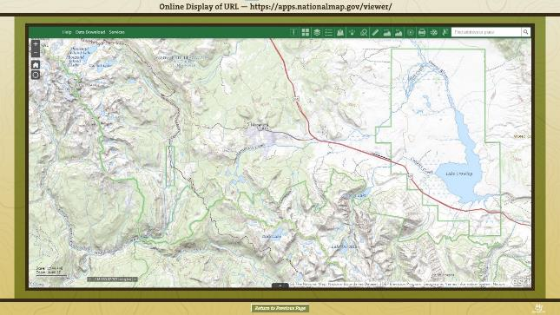
Zooming and moving around the map works exactly the same here as it does in the online CalTrans map from a few slides ago. Use the scroll wheel to zoom in and out, and hold the SELECT button and move the trackball around to move the map around
Play around with the different tools in the green menu bar on top. The ruler allows you to measure air distances between 2 or more locations

Slide 23
PDFs
PDFs with numerous pages will open to this page to allow you to skip through the document. PDFs with fewer pages will simply open to the first page of the document and not have a table of contents
Click on any chapter to skip to it
Guests can scan the QR code to get the PDF on their phone

Slide 24
To navigate through the document, place the mouse anywhere on the cover page and press select. Now you can use the arrows to skip through pages, or use the scroll wheel to scroll up and down
To exit the document, simply press BACK until you get to where you want

Slide 25
Quiz!
The _________ on the trackpad are used to go back and forth between photos
Press _______________ at the same time to open and close the number pad on the computer screen without using the keyboard
What are the 2 ways you can move through a PDF document?

Slide 26
Occasionally, we need to put everything away in 1153 for an event happening in the building. Here’s what we do:
Put all of the animal skins and everything else on the table tops away in the plastic storage boxes under the tables in the cabinets. This includes any pine cones, rocks, or other items on the shelves under the TVs
Anything that somebody can pick up or move should be locked under the cabinets
Trackballs should be turned off and locked in the electronics cabinet. Never stack the trackballs; place them on the shelf next to each other
Carefully remove the bighorn sheep skulls from their display cases and place them in the cabinets wherever there is space. The clear display boxes and wooden/metal bases will go under the stairs right outside of the center
Place the rocks from the rock station under the table behind the cabinet doors and ensure the water is emptied
Remove the tree log from its display and place it under the stairs outside the center. Any removable straps should be put away
Place the sandbox inside a cabinet
The 2 TVs located on the support beam near the center of the room need to be raised so they are unreachable. There is a crank tool in the electronics cabinet you can use to turn the gear to raise the TV. You may need to cut the zip tie holding the TV down. Raise it up high enough that nobody can reach the TV and ensure that the gear is locked using a zip tie so it won’t come crashing down accidentally
Check with a supervisor or events staff to determine if the TVs should remain on or be turned off
Ensure all cabinets are locked
Sometimes the tables need to be removed from the room. The Rock and Map tables go in the back of the storage area next to the bathrooms. If the cafeteria is not open for business, all the other display tables can be stored in the food court, otherwise store them along the walls
Double check that anything that isn’t a built-in installation is put away and locked

Slide 27
Troubleshooting Possible Problems

Slide 28
The Computers
The computer is the small square black box mounted on the wall behind the TV (shown in the image on this slide)
The power button is on either side, or sometimes on the front. The computers and TVs are already be turned on, in most cases
If you need to turn on the computer for any reason (power outage is most common), once the computer is turned on, use the matching keyboard to press CTRL ALT DELETE to open the login page. Confirm the matching trackball is on the appropriate shelf
The password for the “Administrator” account is host_docent
Use the trackpad to double click on the station you want to open
If you need to close the page for any reason to get back to the home screen of the program (not the computer start screen), use the keyboard and hold down Alt, then press F4
Pressing CTRL ALT DELETE any time will quit all programs and take you back to the login page. Never use this unless the computer is frozen
If the computer is frozen, press CTRL ALT DELETE and then Task Manager. Click on the program that is frozen, then End Task on the bottom right. It will force quit it. Then you can restart it from the home page of the computer
Computer power on/off
Blue light means ON
Orange light means OFF

Slide 29
Once you’re logged in and all set, slowly double click this icon. The icon will go with the TV – if you’re on the animals TV, this will say Animal Station
2 exceptions are the Activity and Docent TVs, you can access multiple menus from them so make sure you click the correct one

Slide 30
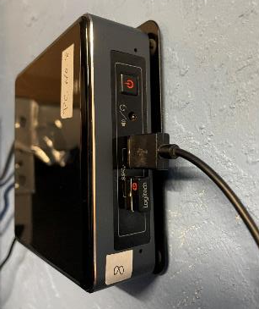
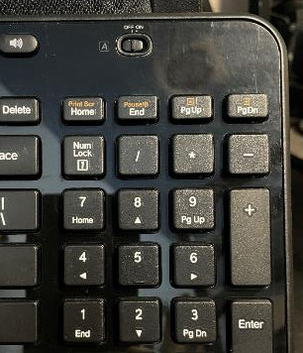
Keyboards
Some keyboards are wireless, and some need to be plugged in
The keyboards that have a wire attached to them get plugged in directly to any computer as shown in the image, NOT the TV. You will never need to plug anything into the TV
The keyboards plug into the USB port on the computer as shown in the top image
Wired keyboards can be used on all computers, regardless of the pairing. Wireless keyboards are assigned to specific computers and are labeled accordingly
Wireless keyboards have an on/off switch
Please ensure wireless keyboards are turned off when not in use. Wired keyboards do not turn on or off

Slide 31
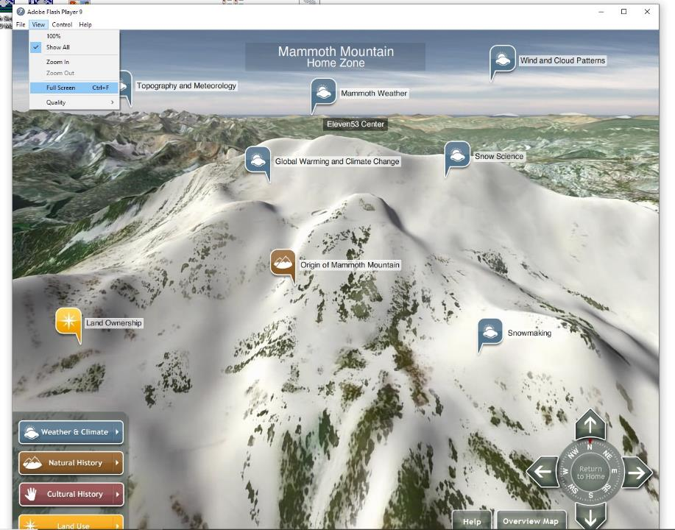
Flyover Station
After a power outage, the weather and flyover stations will need to be reopened
The keyboards are in the electronics cabinet labeled to each station
There is no trackpad or mouse for these touch screens, so use your finger to tap the correct icon and give it a minute to open
It will open in a small window – you must go up to “view” at the top of the page and select full screen
Click on anything on the screen to see more about it

Slide 32
Final Quiz!
The password for the “Administrator” account is ____________
If you need to close the page for any reason to get back to the home screen of the program (not the computer start screen), use the keyboard and hold down ______, then press ______
If the computer is frozen, press _____ _____ _____ and then ______ _______. Click on the program that is frozen, then End Task on the bottom right. It will force quit it. Then you can restart it from the home page of the computer
The wired keyboards plug directly into the _______
When restarting the flyover station, what must you do in order for the program to take up the whole screen?

Slide 33
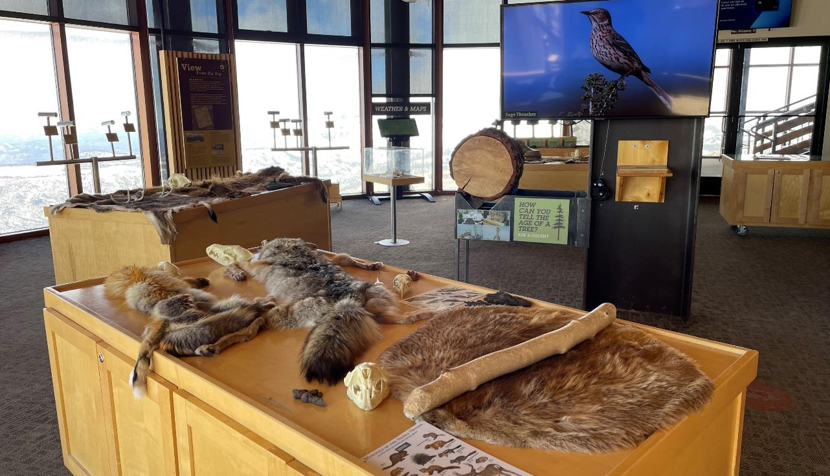
Have Fun ☺

Slide 34
Panoramas
To access panoramas: Docent station - volcanism & geology - volcanism & geology reference materials - Mammoth & June area panoramas
You will need the keyboard to open panoramas
This message will pop up when you click the panoramas. To open them, use the keyboard to hold FN, then press F2.
Click on whichever image you want. It takes a few seconds to open
To move around the image, hold SELECT and move the trackball left or right. The further to the side of the image the mouse is, the faster the image will move
To exit the panorama, move the mouse to the top left of the screen and click file. At the bottom of that menu, click exit. Shown in the bottom image

