Slide 1
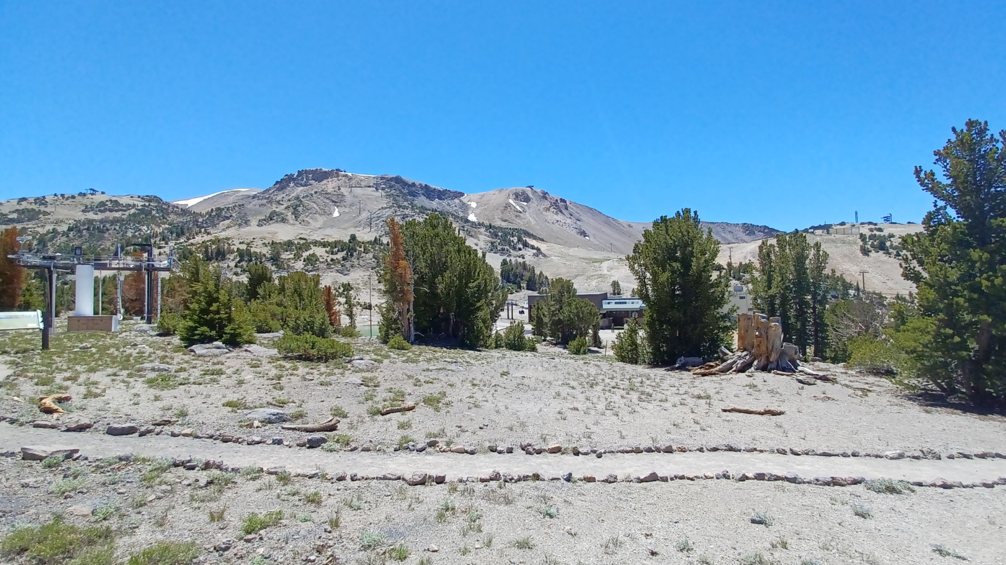
MUSEUM OUTSIDE McCOY STATION
2024 HOST KICK OFF SUMMER
DAVID HARDY and JILL SPARKMAN

Slide 2
A few questions to ask your guest
Hello… My name is David Welcome to the McCoy Museum, How did you hear about us?
Great! What types of pieces of Mammoths history that are located here may be of interest to you and or your family?
As you walk around our museum we have information about each piece of equipment and how they played an important role in Mammoths history.
Would you be interested in a short hike? I would recommend that you hike up our very easy trail which will bring you past our world class weather station and will continue on to the Caldera Overlook!
Does this sound like something that might interest you?
Oh… you had asked about a trail that would be a fun hike down to Main Lodge that would be a relatively easy hike? I would recommend the Main Lodge Trail. I will walk you over to the entrance and you will find the trail very well marked! Well, enjoy your hike and thanks again for stopping by our Museum…
Again my name is David and if I can assist you any further please feel free to reach out to me or any of our Host staff…

Slide 3
Welcome To the Summer Host Orientation 2024
Today we are going to go over all the exciting learning opportunities that the McCoy Museum has to offer to our guest.
Woolly Mammoth
QMC ( Information )
Encourage guest to explore
Surrounding views/highlights
Weather Station
Overlook-Long Valley Caldera
Links for further training

Slide 4
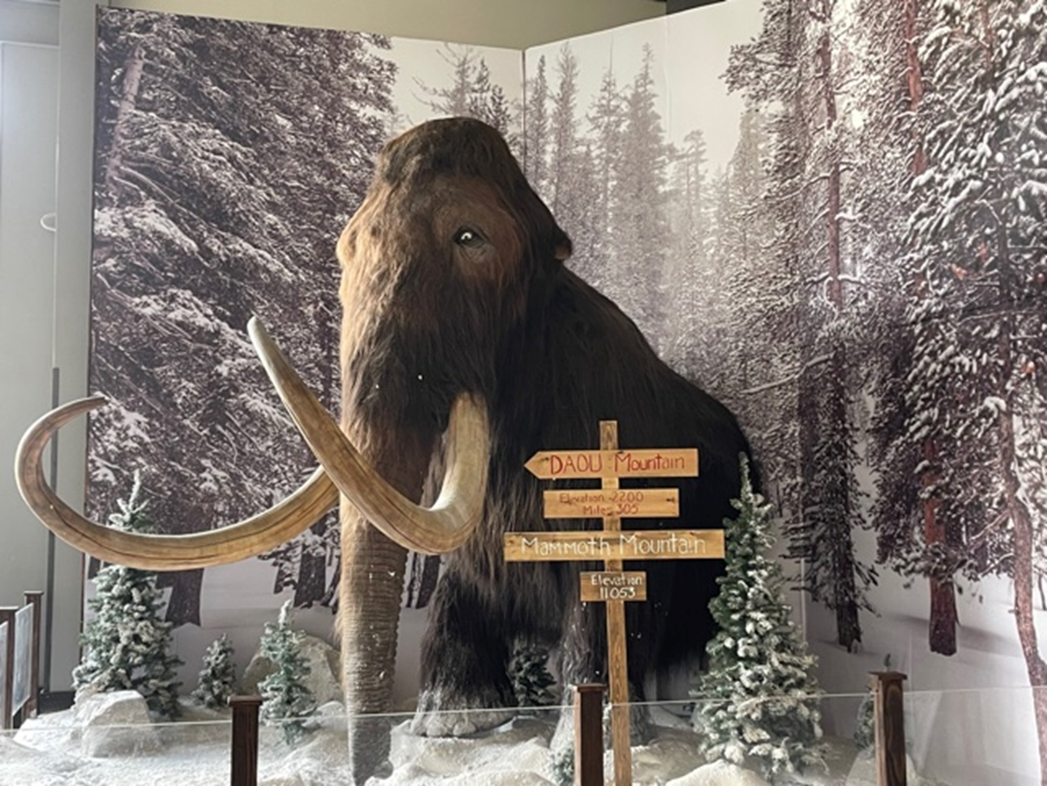
Woolly Mammoth
Be sure to encourage our
guest to visit the Woolly
Mammoth.

Slide 5
QMC (Information)
QMC – Quad Mono Cable
Information station - i.e. trail maps, brochures
https://host-mammothmountain.com/reference/learning/signage_images/museum/quad_mono_cable.jpg

Slide 6
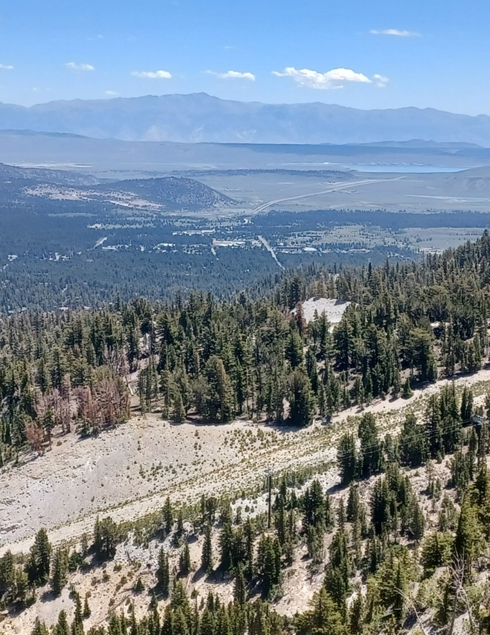
From exploring the museum to the surrounding views encourage your guest to take part in our beautiful surroundings

Slide 7
Weather Station
Be sure to educate yourselves about our top rated research weather station

Slide 8
Resources
Nature and History Tours | Mammoth Mountain
https://host-mammothmountain.com/reference/learning/station_museum.html

Slide 9
Quiz
What is located inside McCoy Station that would be of interest to our quests?
What does Q.M.C. stand for?
Does each station in the Museum have a description of each piece and its function?
What is “Top Rated” as part of the Museum tour?
Where will the walking path lead to?

Slide 10
Notes:
This is the intro/exit slide.

