Slide 1
Village and Mountain Center Activities 2024 Summer Season
Host Kick OffJune 22nd, 2024
Brian Wilson
Notes:
Use this as the last slide

Slide 2
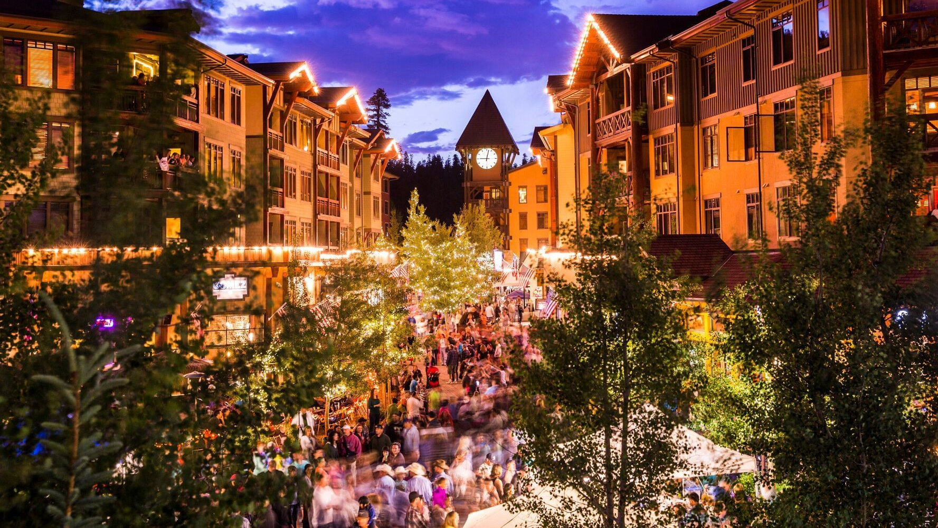
We are the concierge for Mammoth Mountain at the Village

Slide 3
Daily Duties at the Village
Clock in
Wheel out and setup podium along with umbrella
Do not pull out podium in bad weather
Keep the podium clean
Keep an eye on the Bike shuttle and Lakes Basin shuttle
Walk around Plaza, seeking out, and talking with guests. Giving out information and directions
Put podium away, make sure nothing is stored on it overnight. Put brochures under the top!

Slide 4
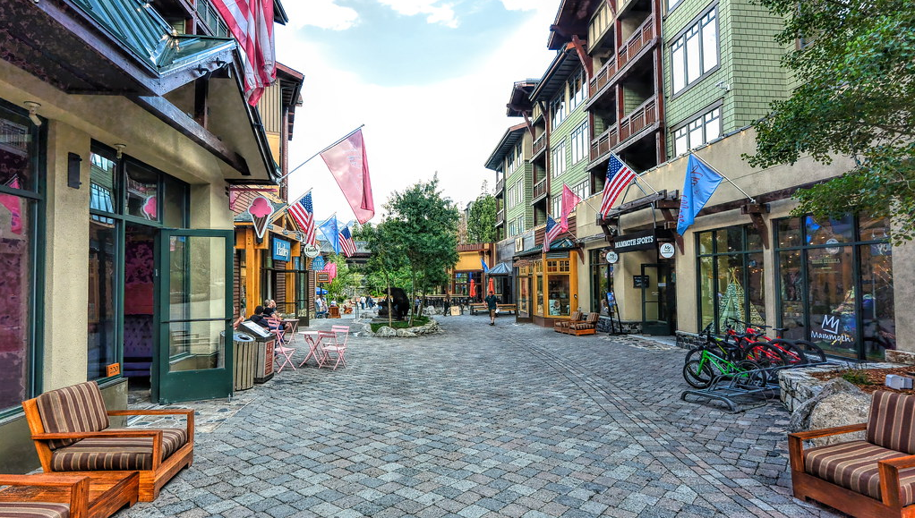
Village Activities
Shopping
Restaurants
Concerts
Festivals
Buses

Slide 5
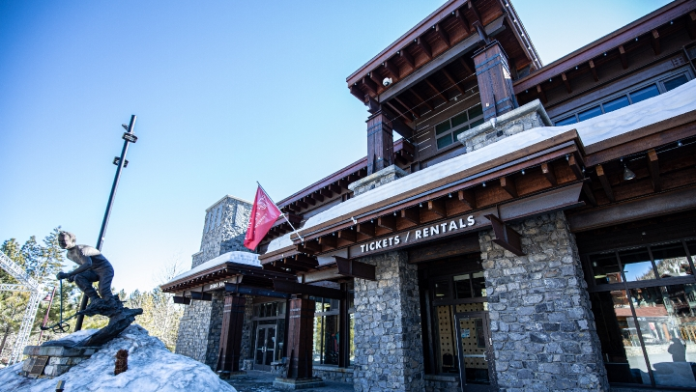
Mountain Center
The Mountain Center is located in the village on the Canyon Blvd side
Bathrooms and water fountains are located inside downstairs
E-bikes, townies, and mountain bike rentals
Demo sale upstairs selling demo skis, snowboards and boots for 50-70% off retail
New skis, snowboards, boots and helmets for sale

Slide 6
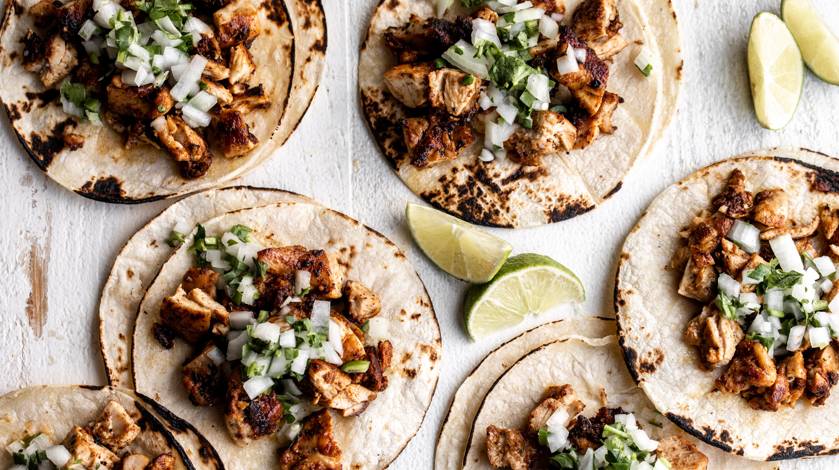
Village Restaurants
Vulcania (Italian)
Gomez’s (Mexican)
Toomey’s (American)
Smokeyard BBQ
Mammoth Pizza Co.
Side Door Café
Pita Pit
New York Bagel & Deli
Burgers
Lakanuki (Hawaiian bar with bar food)
Shelter Distilling (bar with bar food)
Hugs (ice cream)
Patty Shack

Slide 7
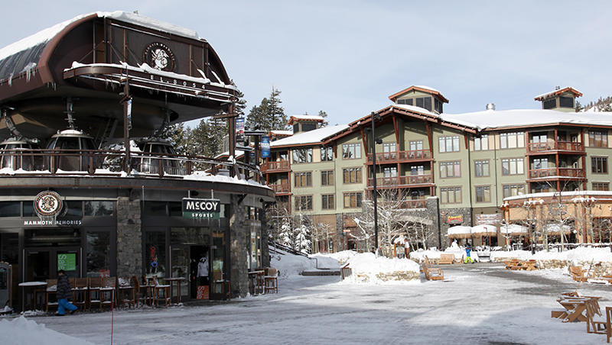
Village Offerings - Shopping
McCoy Sports
(Mammoth brand souvenirs)
Busy Beez General Store
Mammoth Shirts
Mammoth Sports The Village
(ski and bike apparel)
Rider Room
MTB gear
The Mountain Center
(demo sale, skis, boards, boots)

Slide 8
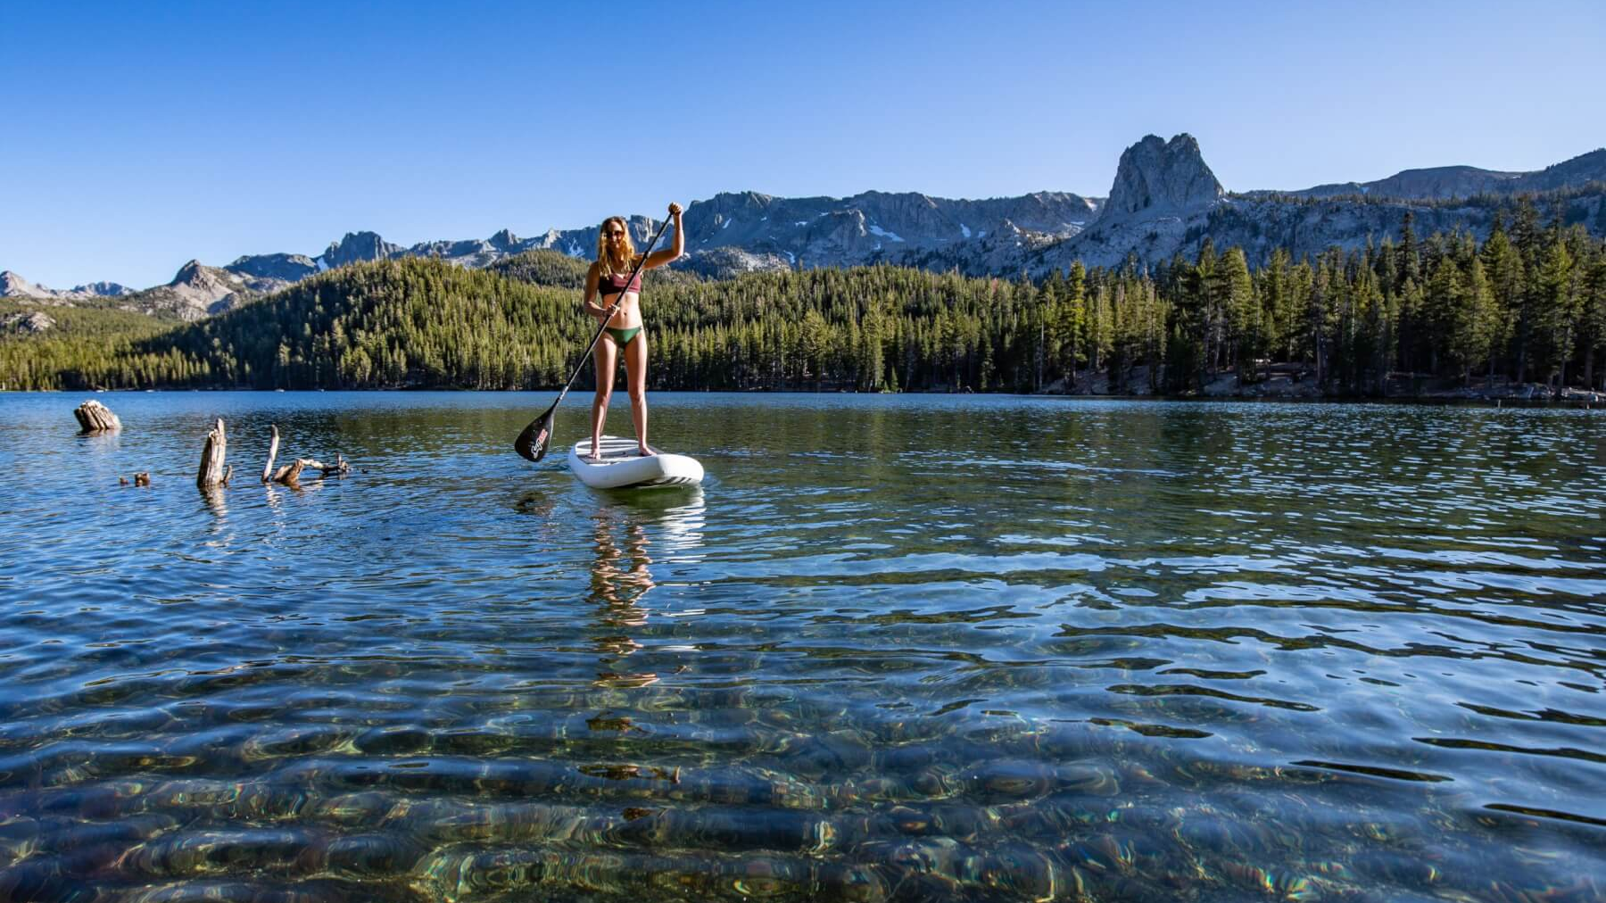
Tamarack Lodge, Activities & Rentals
Kayaks
Stand up paddle boards
Boats
Bicycles
Hiking Trails
Fishing
Lodging and Lakefront restaurant
Camping
Climbing
Swimming in Horseshoe Lake only

Slide 9
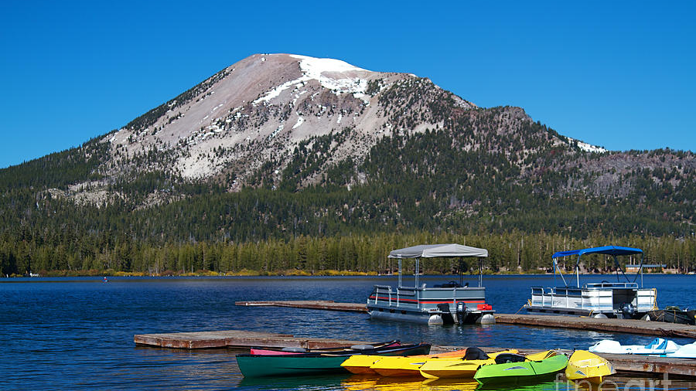
Lakes Basin Boat Rental Locations
Tamarack rentals (At the Yurt)
Lake Mary (Pokonobe Lodge , Lake Mary Marina)
Lake Mamie (Wildyrie Lodge)
Twin Lakes ( Twin Lakes Store, Tamarack Yurt)
Lake George ( Woods Lodge)

Slide 10
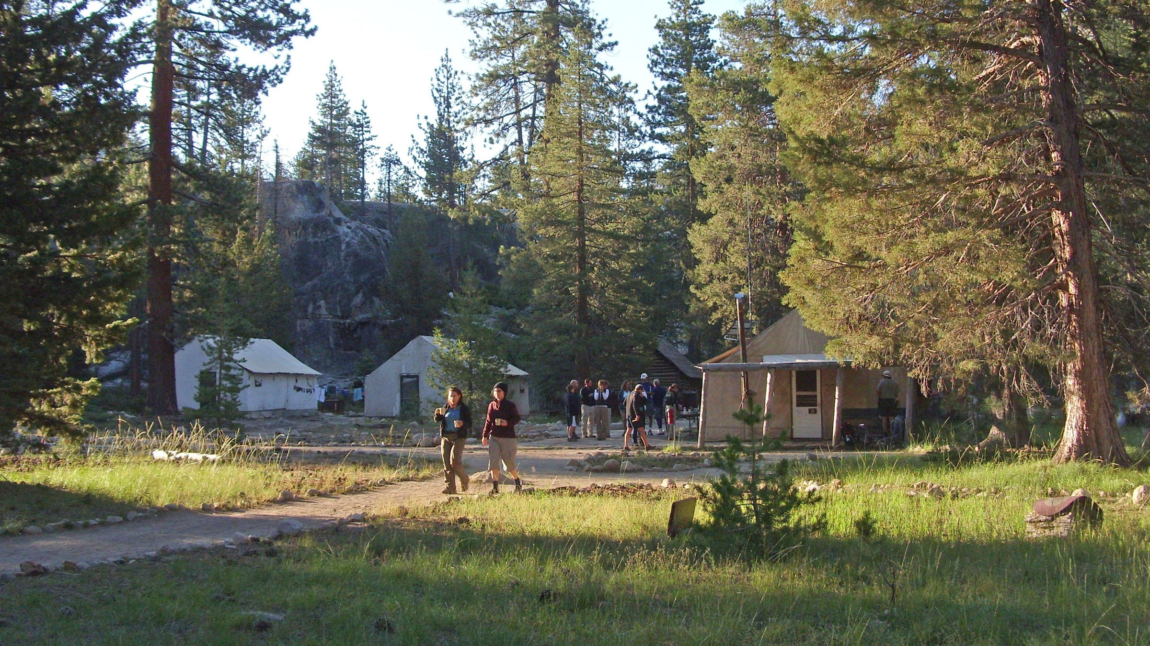
Camp High Sierra
Tents
RVs
Cabins
Campfires
Public Showers

Slide 11
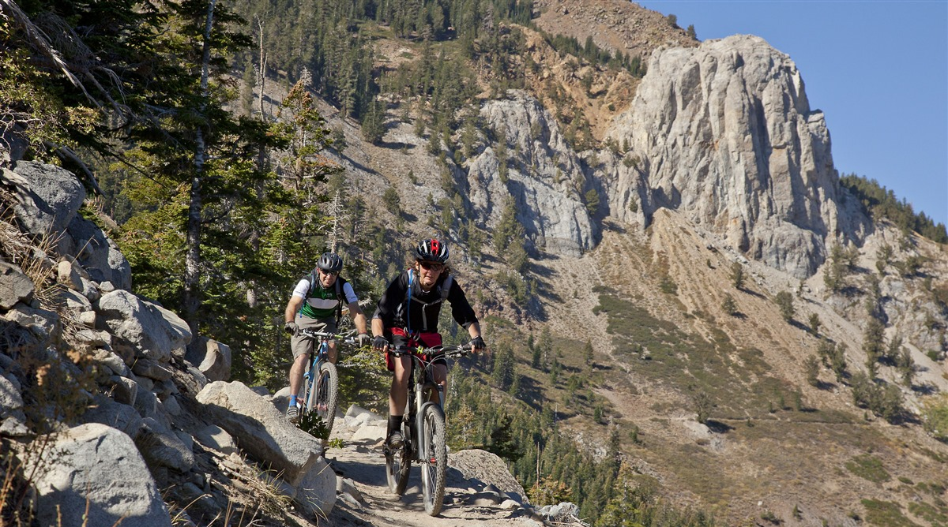
Free Mountain Biking
Sherwin Creek trails
Mammoth Rock trail
Mountain View trail
Lower Rock Creek
TOML Multi Use Paths

Slide 12
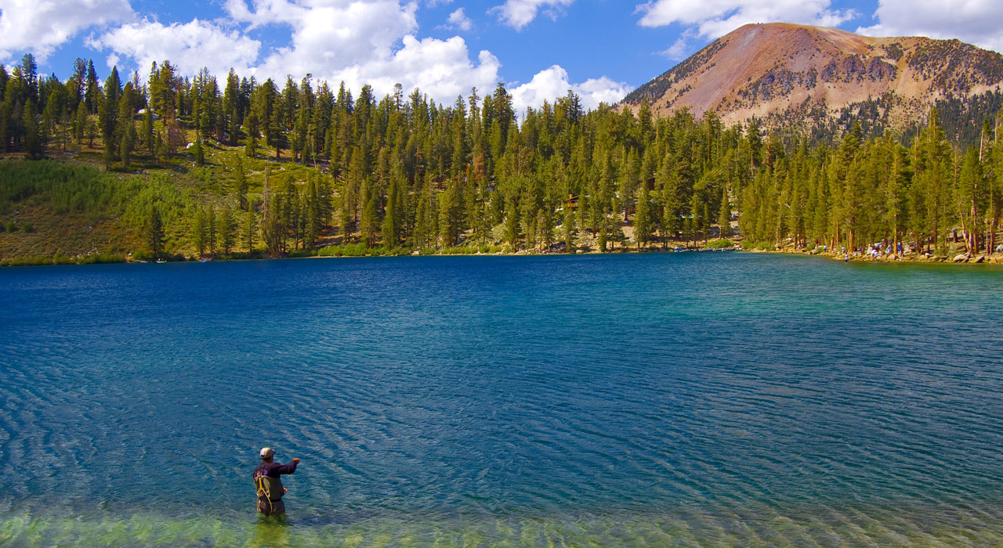
Local Activities
Hiking
Off roading
Fishing
Shopping
Boating
Kayaking
Scenic drives
Biking
Climbing
Camping

Slide 13
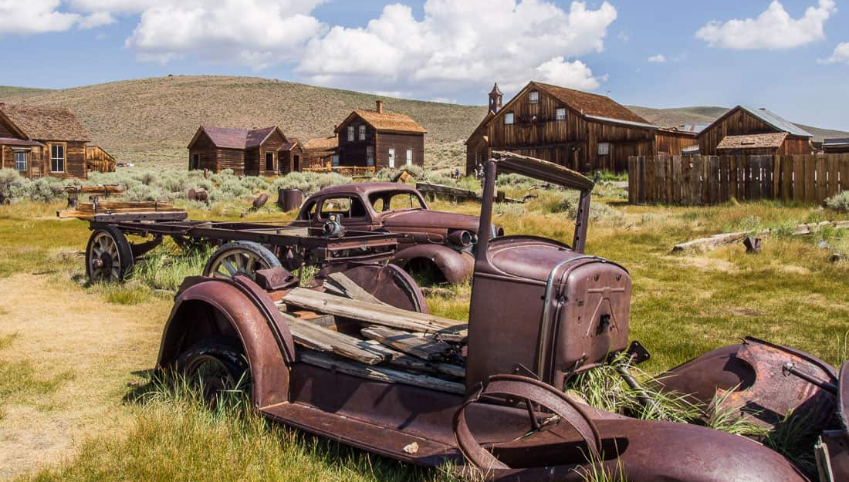
Places To Go
Yosemite
June Lake
Bodie
Mono Lake
Crowley Lake
Convict Lake
Hot Creek

Slide 14
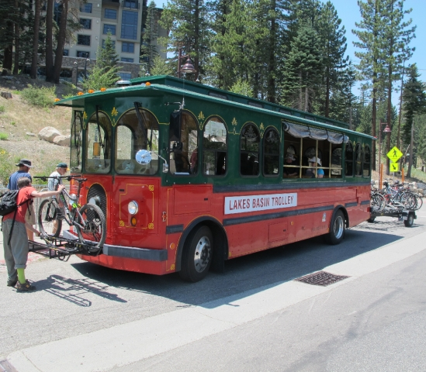
Transportation
1. Fly to Mammoth and Bishop
United to Bishop
10% off: email flylocal@visitmammoth.com for code
Advanced Air to Mammoth
Use code MMHLOCAL for 20% off
2. Buses
Bike Park Shuttle
Town Trolley
Lakes Basin Trolley
Purple Line
YARTS to Yosemite
Reds Meadow- Devil’s
Postpile

Slide 15
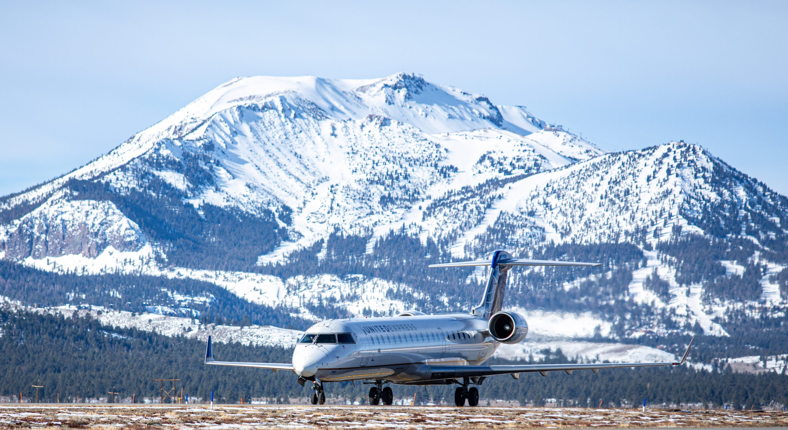
Transportation Links
https://yarts.com/routes/mammoth-lakes-hwy-120e-395/
Flying to Mammoth Lakes - Visit Mammoth
Eastern Sierra Transit Authority (estransit.com)

Slide 16
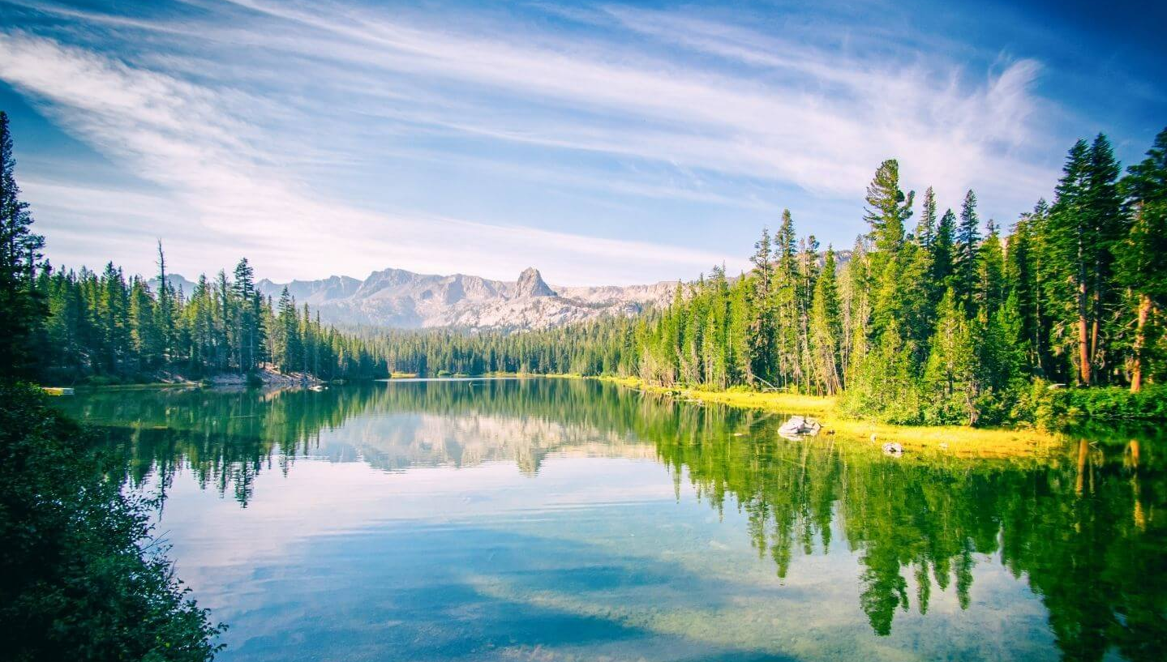
Mammoth is a year round resort, get guests excited about all of our seasons!

Slide 17
Notes:
This is the intro/exit slide.

