Slide 1
2024 Summer Host/Naturalist Kick Off
Review information for Hosts and Naturalists for summer roles. Answer the embedded quizzes, while on the time clock, using your UKG app to log in and out of Payroll.
Notes:
Use this as the last slide

Slide 2
The most critical topics for summer roles and responsibilities of Hosts and Naturalists
Maintain Safety
Understand roles and responsibilities
Participation and how to successfully be a part of our program through appropriate scheduling
Have FUN!

Slide 3
Safety in the Summer
What should you do to keep yourself and our guests safe?

Slide 4
The most critical topics for summer safety
Personal awareness
Summer thunderstorms protocol
Spatial awareness
See Something, Say Something

Slide 5
Personal Awareness
Be aware of your well-being
Protect yourself from the sun
Sunscreen or other sun protection, for example long sleeves
Hat, eye protection
HYDRATION
Stamina
Avoid standing in one place too long
Take appropriate breaks
Weather
Prepare for changing weather

Slide 6
Summer Thunderstorms
Mammoth’s Mountain Operations
Monitors any storms in the area and announces activity within 15 miles on the Mammoth Mountain radio
Attempt to avoid potential exposure
The warning system used and announced over the radio
Lightning 12 – 18 miles away generates an advisory alert
Lightning 8 – 12 miles away generates a cautionary alert – scenic riders are stopped from loading the Panorama Gondola and all riders at the top or McCoy are immediately downloaded
Lighting closer than 8 miles closes all lifts and activities at the Adventure Center but not Mammoth Mountain Bike Park trails or buses
Operation MAY recommence when no lightning has occurred within the cautionary range (8 -12 miles) during the last 15 minutes

Slide 7
Spatial Awareness
Be aware of what and who is around you
Always be prepared for drivers unfamiliar with our summer driving pattern in loading/unloading
Look for small children who might be separated from their families
Many guests can be out of their comfort zone; empathize and assist
Use the crosswalk to cross the road after 203 opens fully to the Minaret Vista
Ask bike riders in the Adventure Center to walk their bikes

Slide 8
See Something, Say Something
Hosts and Naturalists, or guests who share information, are often able to see something that could be wrong
Do not ignore problems as our team can help prevent a bigger problem from arising
Suggestions of things to look for
Notice a guest who is struggling with the altitude
Trip hazards
Equipment concerns
Loose pets
Smoke
Call 760.934.2571, ext. 3250 to share most problems
Call 760.934.0611 if it is urgent (guest health problems, lost child)

Slide 9
Quiz
Who is the most important person to take care of?
What are ways to take care of yourself?
Why do we need to listen to the radio?
When does the Panorama Gondola stop loading guests during thunderstorms?
Why do we need to be careful when heading to the Adventure Center?
Why should you speak up when you see something that does not appear right?

Slide 10
Host and Naturalist Strategies
Support our mission to Help our Guests Create Great Memories
Make an impact on our guests
Techniques we use to succeed
Have fun to ensure our guests are having fun!

Slide 11
1. Make our Guests understand we want them here
Engage the Guest through eye contact, smile and speaking first
Welcome guest to Mammoth and ask “How may I help you?”
Thank our Guests for Choosing Mammoth

Slide 12
2. Determine Desires and Promote Services
Use L.A.S.T. (Listen, Acknowledge, Solve and Thank)
Use clues, such as what guests are wearing, to help guide ideas
Focus on Mammoth Mountain Activities
Suggesting activities beyond Mammoth Mountain are also great suggestions
Know where to get answers when you are unsure

Slide 13
3. Use Your Best Judgment
What’s best for our Guests
What’s best for the Mountain
What’s best for You

Slide 14
4. Have a plan, but adapt as necessary
Prepare your day, depending on your assignment
Learn ways to solve problems using Mammoth Way standards for your assignment
Recognize new information can be used to adjust responses to guest’s needs

Slide 15
Focusing on our Guests Promotes Our Business
Build your Mammoth and local area knowledge to offer guests the best responses
Always focus on Safety
Maintain flexibility to move wherever the guest needs are
Maintain efficiency, disengaging appropriately to provide assistance to as many guests as possible

Slide 16
Quiz
Have _____ to ensure our ______ are having fun!
Ask guests “How _______ I help you?
Determining Desires and Promoting Services is initiated using __.__.__.__.
Using your best judgment means determining
What’s best for the _________
What’s best for the _________
What’s best for _______

Slide 17
Quiz
Have a _______, but _________ as necessary
Solve problems using __________ _____ standards
Build your Mammoth and _______ _______ knowledge to offer guests the best responses
Always focus on __________
Maintaining efficiency occurs when _____________ appropriately

Slide 18
Mammoth Way We succeed by utilizing it!
“The Mammoth Way is the cornerstone of our guest experience. Derived by looking thru the eyes of the guest, we identify touchpoints, standards, and success activities with programed and spontaneous measurement, feedback and celebration.”

Slide 19
Mammoth Way – Guest Experience Trail
800Mammoth or MammothMountain.com
To Book
Scenic Panorama Gondola*
Eleven53 Interpretive Center*
Woolly and the Great Memories made*
Touchpoints where Hosts interact with guests
High Impact Guest Touchpoints with Host interactions
Touchpoints where Hosts hand off guests to employees working these areas
Touchpoints where Hosts do not interact with guests
Food & Beverage
Tamarack
Hotels
Adventure Center*
*
Activities*
Transportation
Town Activities
Tickets*
Retail
Front Line Loading/Unloading*
Entry Points
Bus Lines*
Mountain Center at the Village*
Supersigns and Wayfinding

Slide 20
Experience Standards
Standards create the feeling you want your guests to have through your interactions
Often repeated Standards include
Warm, Friendly Greeting
Accurate Information and Directions
Engaging Guests
Promoting Activities and Events
Animating the Resort
Enhancing Safety

Slide 21
Success Activities
Observable, repeatable, pinpointed activities to perform that achieve Experience Standards
Activities include
Upbeat, professional, positive attitude
Make our guests feel we want them here
Share appropriate information
Support Mammoth Policies and Procedures
Determine needs and desires through pinpointed questions
Maintain communication with Mountain Operations for safety

Slide 22
Quiz
Mammoth Way is the _____________ of our __________ experience
List 3 High Impact Touchpoints
Standards create the __________ you want your guests to have through your interactions
Success Activities are repeatable and pinpointed. True or False?

Slide 23
Host Scheduling with “When I Work”
Be sure to provide input on time
Complete the Safety Topic/Maximum Days form each month
Edit your availability when it changes
When your schedule changes and you can no longer cover the shift, follow the steps to cover the shift you were assigned
IF YOU ARE SICK, PLEASE DO NOT COME TO WORK, but let us know you need to cancel as soon as possible

Slide 24
Availability
Enter Availability on your Monthly Calendar
Availability is your days marked “I Prefer to Work” and your days marked “I’m Unavailable to Work” on the Monthly Availability calendars
You can enter the entire season or one month at a time
Availability can be edited at any time
For scheduling purposes, your availability is not viewed until the 10th day of the previous month (i.e. July 10 for August scheduling)
Edit days you prefer to work, including your preferred time
Edit days you know you can not work
Leave days you could work but are not your preferred days as blank day

Slide 25
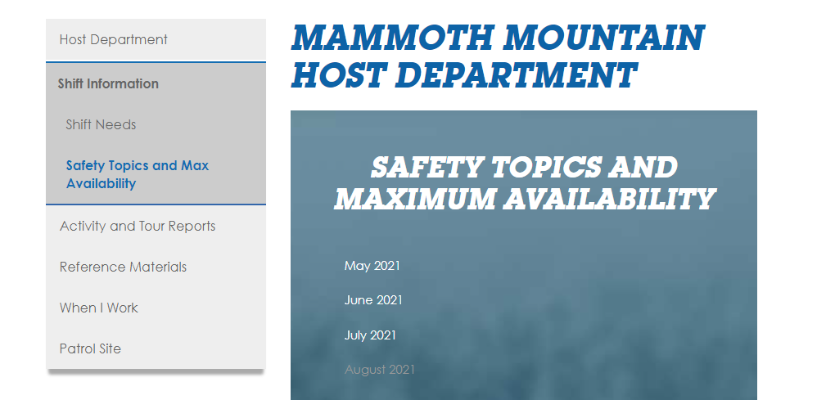
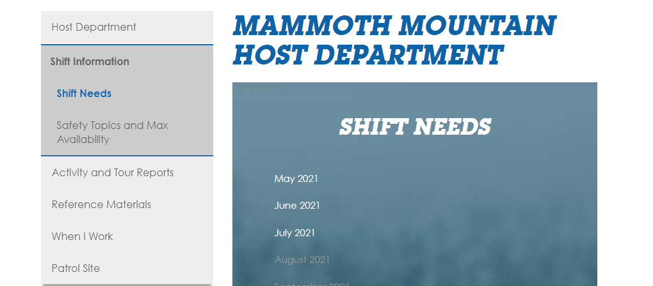
Availability – Find out information on what is needed
Shift Information on the Host website provides
Information regarding Shifts needed to be filled
Monthly Safety Topics certification, which also includes details used to create the monthly schedule
Only months that are “lit” can be opened

Slide 26
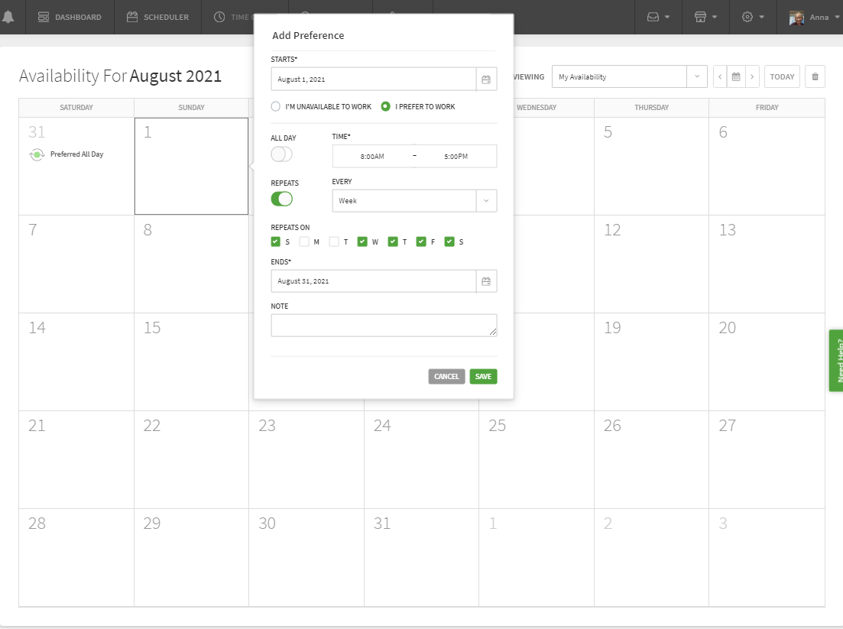
Adding Availability
When adding a date for “I Prefer to Work,” the DEFAULT shows as “I’m Unavailable to Work”
The time of day you prefer to work is changed from 9:00AM – 5:00PM by either selecting “All Day” or changing time manually
Repeat Days can be entered after entering just one day, if desired
Notes are only visible if the availability calendar is opened for the specific day (or days if repeat was used), making it very difficult to obtain when scheduling

Slide 27
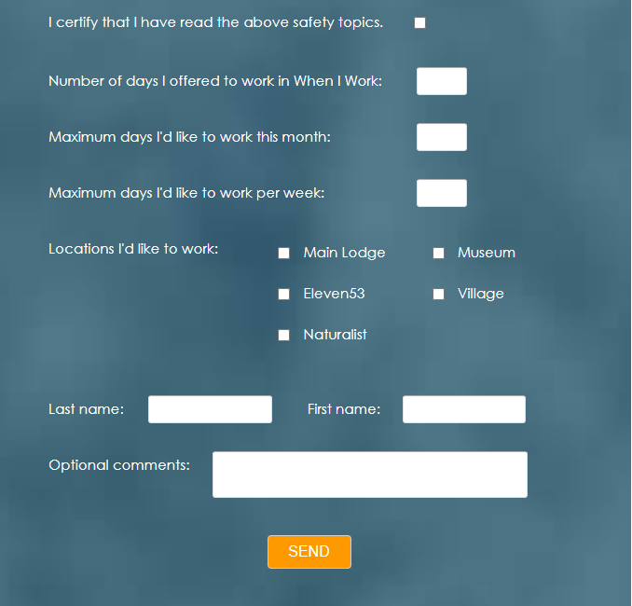
Safety Topics and Maximum Availability Form – Complete it by the 10th of each month!
Complete the information following the Safety Topic certification
Total days you as preferred to work (Required)
Of all your offered day, how many would you prefer to work? This number should be equal or lower than total days offered (Required)
Maximum days you want to work within any week (optional)
All locations you prefer to be scheduled at (required)
Name (required)
Any comments to help define your schedule (optional)

Slide 28
Changing Plans and Availability
After the scheduled is complete and published, around the 15th of the month, your planned activities are likely to change
Edit your availability to reflect your new plans
When a shift needs to be filled, displaying your current changes helps other Hosts when they are looking for replacements
When the Management Team is covering an emergency absence, the information is critical

Slide 29
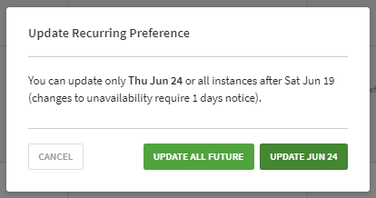
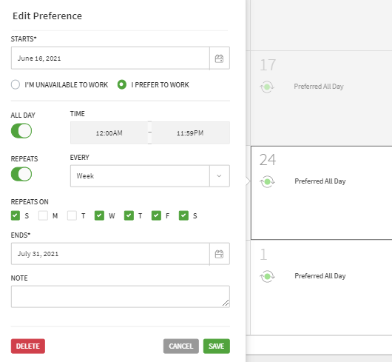
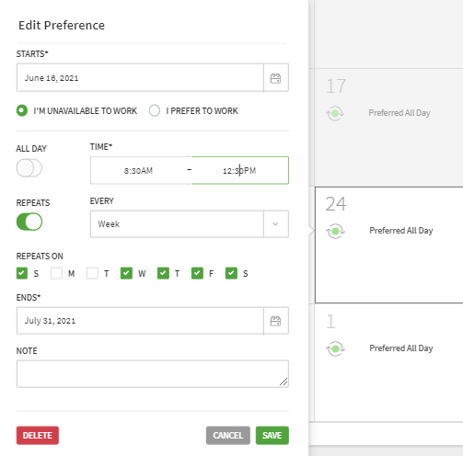
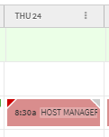
Choose to “Update Jun 24” unless all dates are changing
Make necessary changes
This example will change the day to unavailable from 8:30AM to 12:30PM
This schedule page shows a gray triangle for June 24 only, indicating unavailable time, with a red triangle, indicating a conflict.
Editing Availability
Select a day and hover over the information to display “Edit” and select

Slide 30
Your Availability Changed and you are Scheduled – What now?
You have options to request a change to your schedule
Until you are able to get another Host to cover your shift, you are responsible for covering it!
To make a change to the schedule, it is your responsibility to manage, unless it is an emergency
Emergencies include illness, family who lives with you who is ill, other family tragedies

Slide 31
Drop Shift
When unable to cover a shift due to availability change, Drop Shift allows you to offer a shift to an employee who is available
You are responsible for covering the shift until you have managed with a co-worker to cover the shift
On My Schedule (found below your Profile), select your schedule, select “Get Shift Covered” then “Drop Shift
Employees who are qualified to cover your shift appear
Check the schedule to see if those employee(s) really are still available and might want to work by looking at their schedule

Slide 32
Drop Shift
Call, text or email Hosts who have a green triangle showing on the schedule but no shift scheduled or who otherwise appear to be available
Hovering over the green triangle shows available time
As long as the Host has not enabled Privacy, phone numbers and emails are visible when clicking on employee details
Select the Host who agreed to cover your shift and submit it, including a note you confirmed the Host is covering the shift
Respect other Hosts by asking if they are available and interested before choosing them
Host Management Team approves the Drop Shift
The replacement Host receives notification of the request, providing them the chance to accept the shift, as planned

Slide 33
Swap Shifts
When unable to cover a shift due to availability change, Swap Shift allows you to offer a shift to an employee who is available and to cover a shift of theirs
You are responsible for covering the shift until you have managed with a co-worker to cover the shift
On My Schedule (found below your Profile), select your schedule, select “Get Shift Covered” then “Swap Shift”
Employees who are qualified to cover your shift appear with the assigned shifts you are qualified to cover
Check the schedule to see if employee(s) are actually available and want to work by looking at their schedule and comparing it to your available days

Slide 34
Swap Shifts
Call, text or email Hosts to confirm they are able and willing to swap a specific shift with you
As long as the Host has not enabled Privacy, phone numbers and emails are visible when clicking on employee details
Select the Host who agreed to swap shifts and submit it, including a note you confirming you are swapping shifts
Respect other Hosts by asking if they are available and interested before choosing them
Host Management Team approves the Swap Shift
The replacement Host receives notification of the request, providing them the chance to accept the shift, as planned

Slide 35
Oh No – I Woke with a Sore Throat, Now What?
Emergencies happen. IF YOU FEEL UNWELL STAY HOME!
Send a Drop Shift message on When I Work to communicate you are not feeling well
Select all Hosts to cover shift
Management Team will deny and set the shift up as an open shift to see if anyone is available at the last minute
Use this Drop Shift method for short, emergency notice only
Communication can also be sent through Work Chat

Slide 36
Quiz ☺
When is availability on When I Work Availability calendars due?
What information is needed on When I Work Availability calendars?
What page on the Host website provides information about the planned needs for creating the monthly schedule?
Where do you include the maximum number of days you prefer to work for the month, as well as the locations you are interested in working? When is that information due?

Slide 37
Quiz ☺
Your son just called you to say his daughter qualified to compete in a state level championship game and you do not want to miss it. You are not scheduled to work but you offered availability. What do you do on the When I Work Availability calendar?
A close friend called to say they are coming to Mammoth and want to go fishing with you, but you are scheduled to work. Describe the steps you must take to drop your shift.
State the difference between Drop Shift and Swap Shifts
You wake up with the first cold of the year and you know it’s not allergies. What is your responsibility regarding the shift you are scheduled to work?

Slide 38
Important Resources
Host Website - https://host-mammothmountain.com/
Contains manuals, Eleven53 presentations, training materials, maps, and more.
Summer host manual (host website>reference materials)
Contains detailed descriptions of expectations, success activities, applicable policies, and general info.
Guest experience trail / Mammoth Way (found in manual)
Guide to providing the best guest experience possible.
Daily briefing (found on host website home page)
Resource for finding today’s activity and ticket prices

Slide 39
Thank you for reviewing the 2024 Summer Host/Naturalist Information Have A Mammoth Day!
Notes:
Use this as the last slide

